Slide 1
1: Working at Computer 2: Standing Up, Walking and Going Up/Downstairs 3: Standing 4: Walking 5: Going Up/Down Stairs 6: Walking and Talking with Someone 7: Talking while Standing

Slide 2
1: Working at Computer 2: Standing Up, Walking and Going Up/Downstairs 3: Standing 4: Walking 5: Going Up/Down Stairs 6: Walking and Talking with Someone 7: Talking while Standing

Slide 4
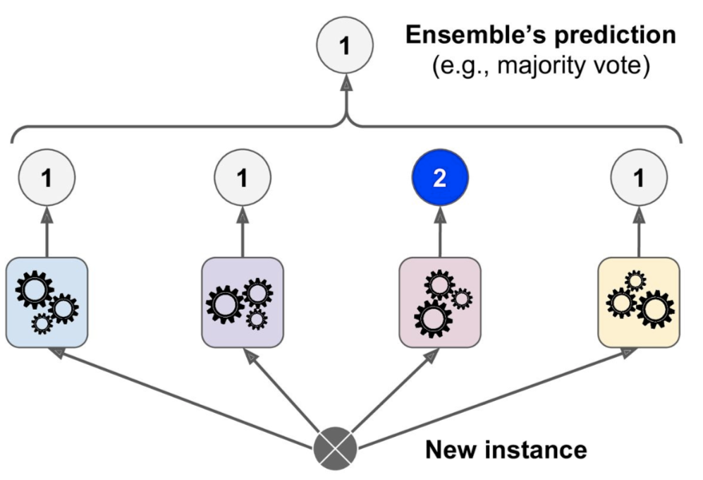
Working
Standing
Walking
Going up stairs
Class 1
Class 3
Class 4
Class 5

Slide 5
FFT
FFT

Slide 6
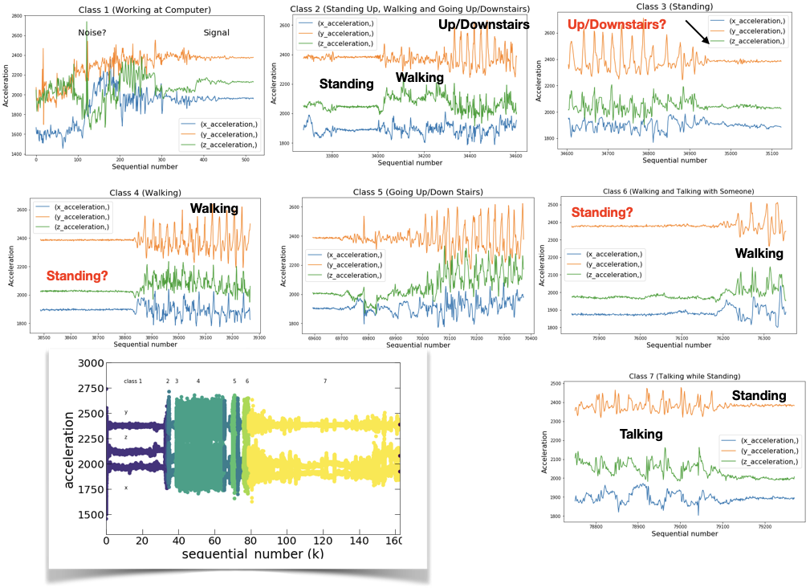

Slide 9
